Slide 1
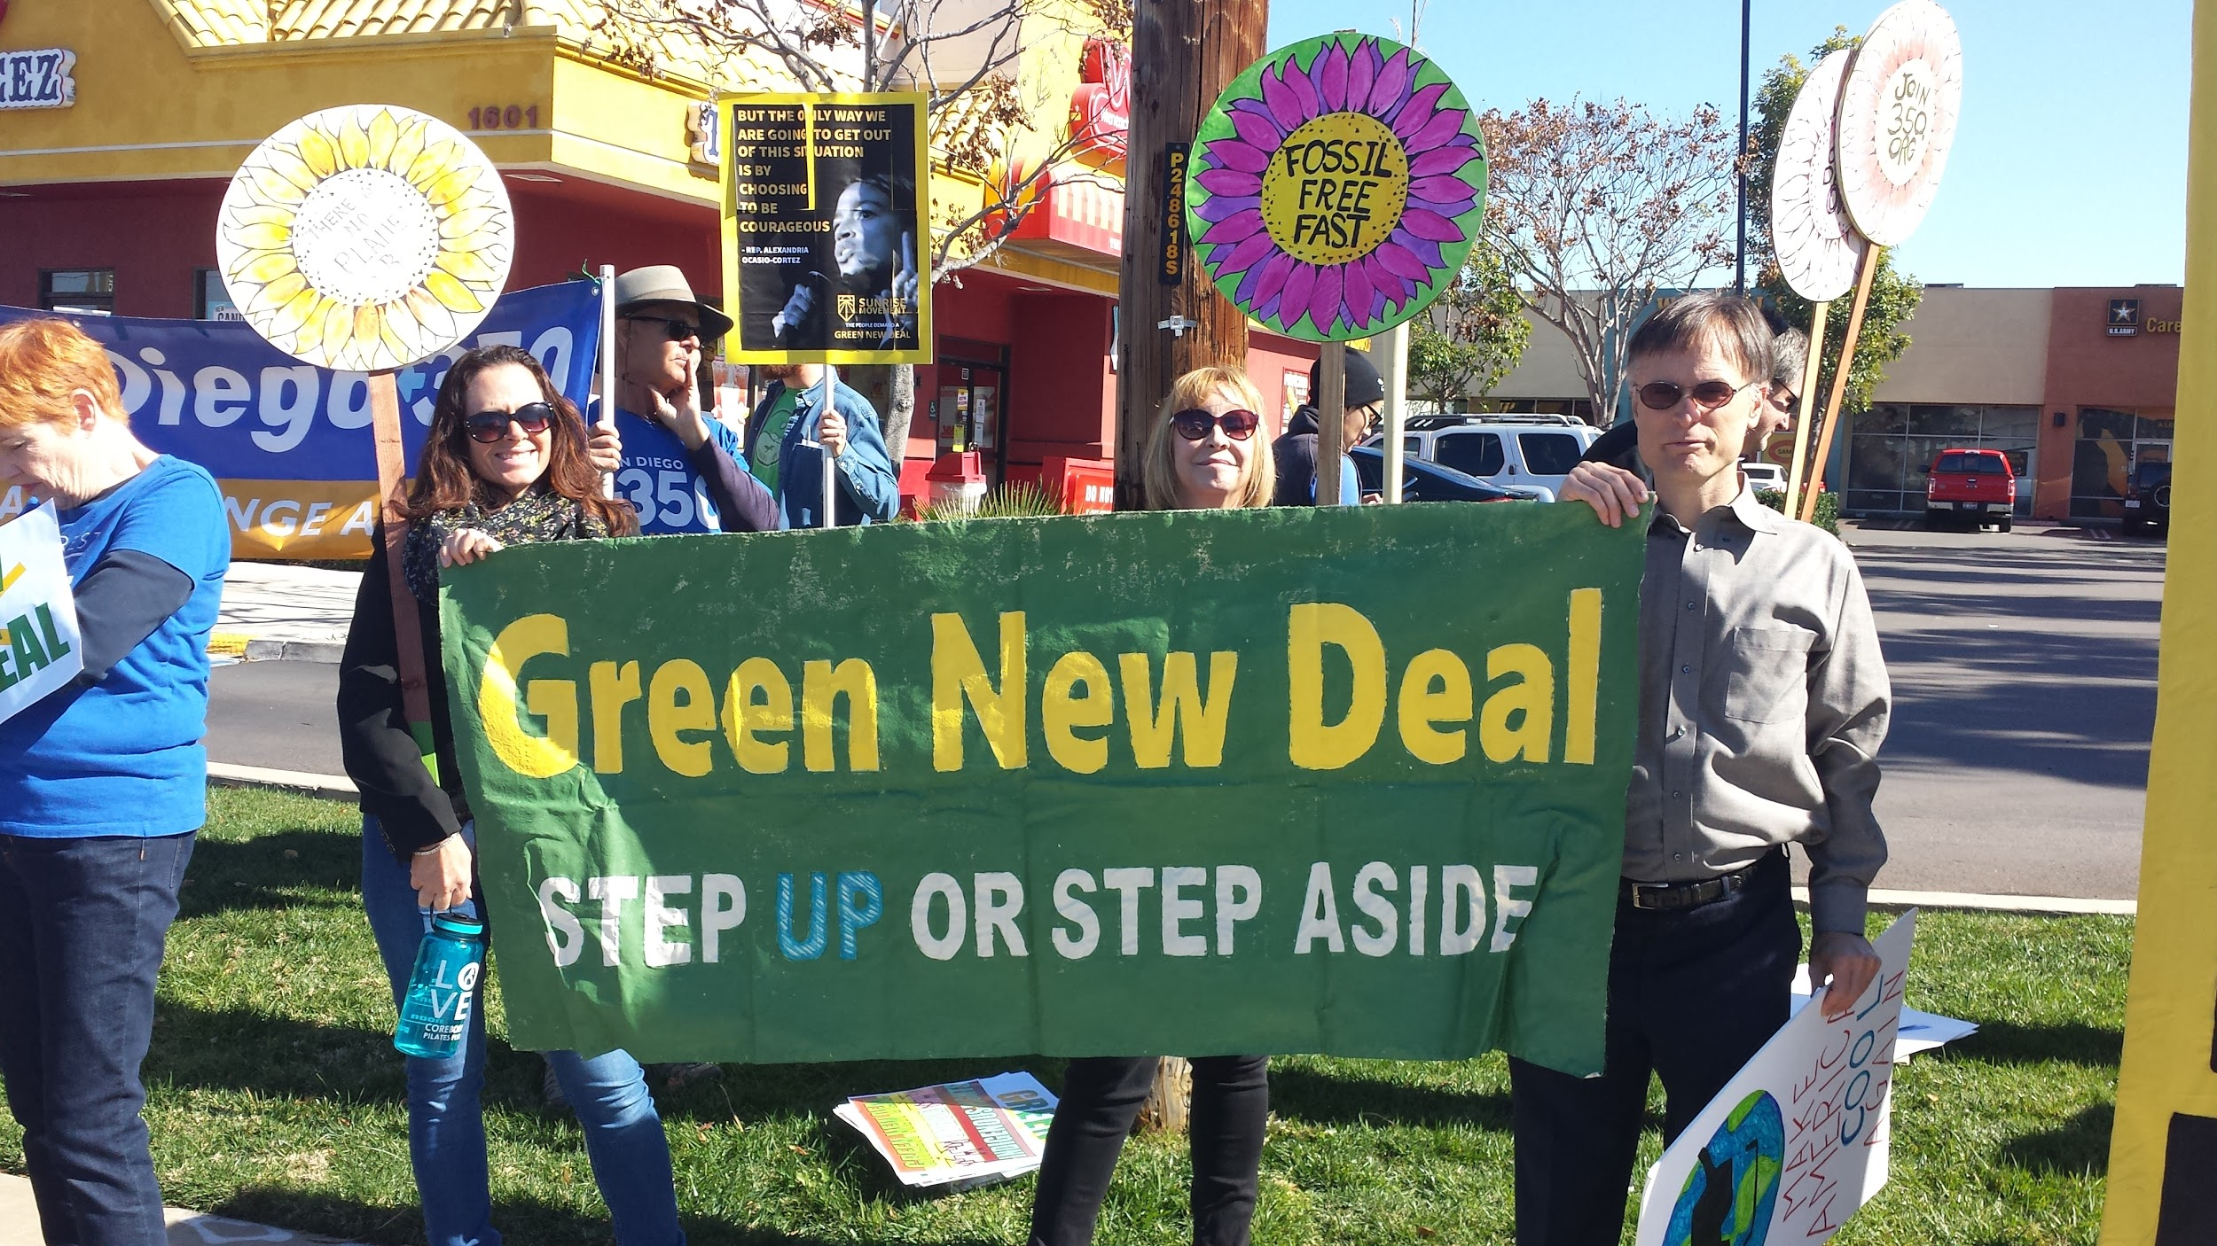

Slide 2
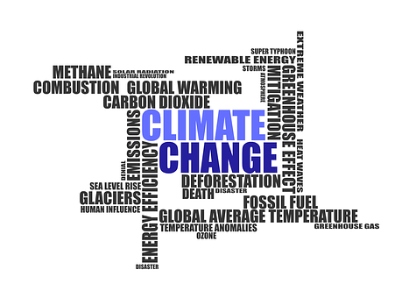

Response to the Twin Emergencies of
Climate Change and Economic and Social inequality

Slide 3
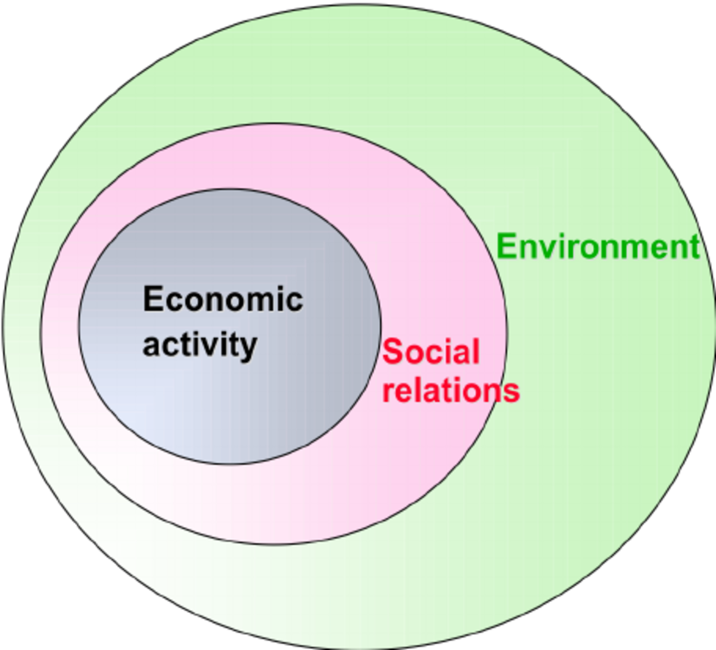
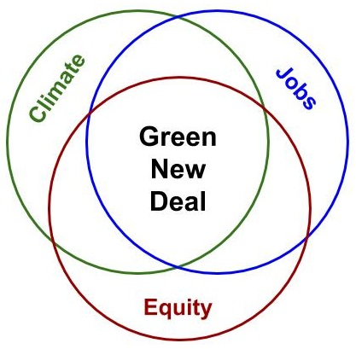
Three pillars of Sustainability:
Environment, Economy, Equity

Slide 4
The Green New Deal is not a single policy intervention. It is a just and equitable multi-pronged policy approach to transform our economy and energy system and help build sustainable and resilient communities. Sandiego350 is advocating for the following key actions by Congress and the Administration:
Halt all new fossil fuel extraction, infrastructure and subsidies, and transition power generation to 100% renewable energy by 2035 or sooner.
Rapidly decarbonize agriculture and transportation sectors and expand access to public transportation.
Ensure a Fair & Just Transition led by impacted workers and communities, including low income and communities of color, without relying on corporate schemes or market-based mechanism
Uphold Indigenous Rights

Slide 5
SUGGESTED RESOLUTION FOR THE CLUB TO PASS
THEREFORE BE IT RESOLVED that the _________________ Democratic Club supports the Green New Deal resolution and the no Fossil Fuel Money Pledge, and calls on the San Diego Congressional delegation* to: 1) cosponsor the Green New Deal Resolution; 2) sign the no Fossil Fuel money pledge and commit to refusing political contributions from the fossil fuel industry; and, 3) hold a town hall meeting in their district in San Diego County by the August 2019 recess to dialogue with constituents on climate change.
BE IT FURTHER RESOLVED that this resolution be sent to the California US Senators and Congressional Representatives to take the actions identified.
* The Club, if it chooses, may also ask other elected representatives to take these pledges.

Slide 6
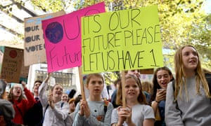
SUPPORT GRETA THUNBERG INSPIRED GLOBAL CLIMATE STRIKE
Sept 20-27th
https://350.org/support-climate-strikes/
SanDiego350 contact: bwellhouse@gmail.com, jaysd350@gmail.com

Slide 7
House (Green New Deal) Resolution 109 Text
-Achieve net-zero greenhouse gas emissions through a fair and just transition for all communities and workers;
- Create millions of good, high-wage jobs and ensure prosperity and economic security for all people of the United States;
-Invest in the infrastructure and industry of the United States to sustainably meet the challenges of the 21st century;

Slide 8
HR 109 Continued
-Secure for all people of the United States.. for generations to come -(i) clean air and water;(ii) climate and community resiliency; (iii) healthy food; (iv) access to nature; and (v) a sustainable environment; and
- promote justice and equity by stopping current, preventing future… historic oppression of indigenous peoples and “frontline and vulnerable communities”.

Slide 9
Examples of what HR109 states
- Global reductions in greenhouse gas emissions 40 to 60 percent from 2010 levels by 2030;
- Net-zero global emissions by 2050;
- Removing greenhouse gases ... restoring natural ecosystems through proven low-tech solutions that increase soil carbon storage, such as land preservation and afforestation;
- Restoring and protecting .. ecosystems through locally appropriate and science-based projects that enhance biodiversity and support climate resiliency;
- Renewables, EVs, Mass Transit, High Speed Rail, Smart grid, Urban planning, upgrading building ..

Slide 10
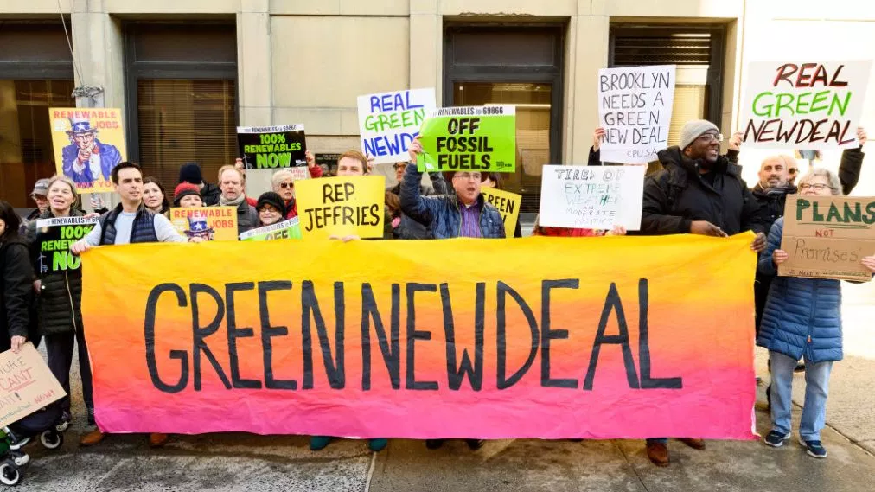
Examples of what HR109 states
Guarantees the following:
- a job with a family-sustaining wage, adequate family and medical leave, paid vacations, and retirement security to all people of U.S.
- wage and benefit parity for workers affected by the transition
- universal access to clean water

Slide 11
The Green New Deal agenda is both feasible and affordable. This will become clear as the agenda is turned into specific legislation for energy, health care, higher education, and more….The Green New Deal combines ideas across several parts of the economy because the ultimate goal is sustainable development. That means an economy that delivers a package deal: good incomes, social fairness, and environmental sustainability. Around the world, governments are aiming for the same end -- a "triple-bottom line" of economic, social, and environmental objectives.
- Jeffrey Sachs

Slide 12
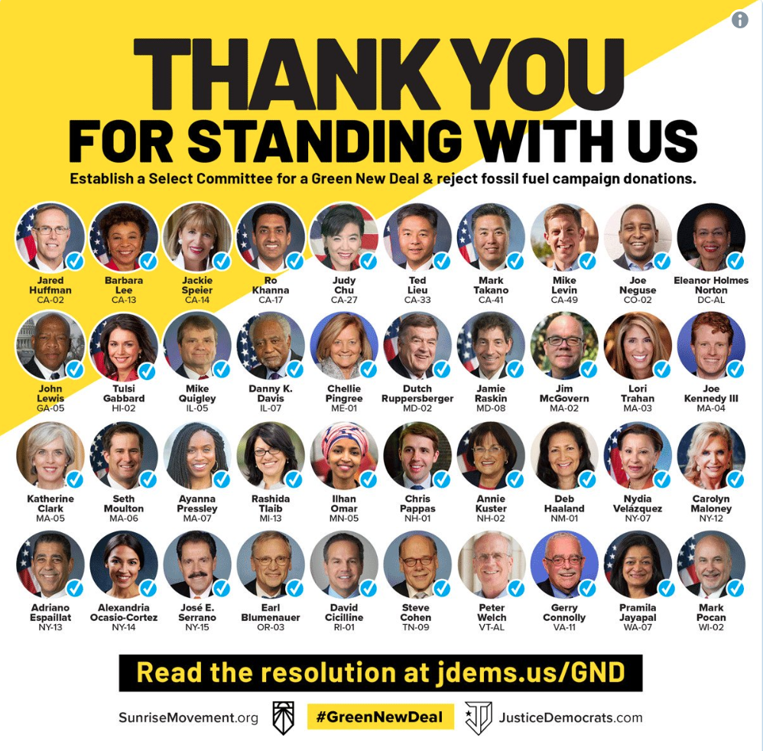
Where the Green New Deal is headed:
Here are some legislative scenarios in 2021:
Best case: pass a Green New Deal.
  Requires Dem trifecta and repeal of filibuster.
Mid case: ambitious climate legislation seen as reasonable alternative to “Green New Deal”
  Requires Dem gains, but could move through budget reconciliation.
Worst Case: Trump wins. We turn to state and local fights.
REGARDLESS OF WHAT HAPPENS, THE GREEN NEW DEAL HAS RAISED
THE FLOOR OF WHAT IS ACCEPTABLE FOR ACTION ON CLIMATE & INEQUALITY
Notes:
Add about how we see this as a moment to envision to last line, how much the debate has changed (before after, lack of Republican response), pictures of articles

